Slide 1
Working with React Class Components-Props and Event Handling

Slide 2
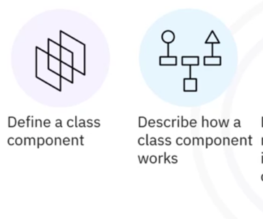
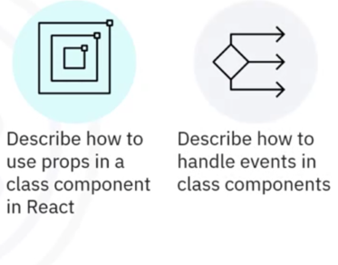

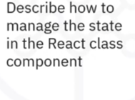
What you will learn

Slide 3
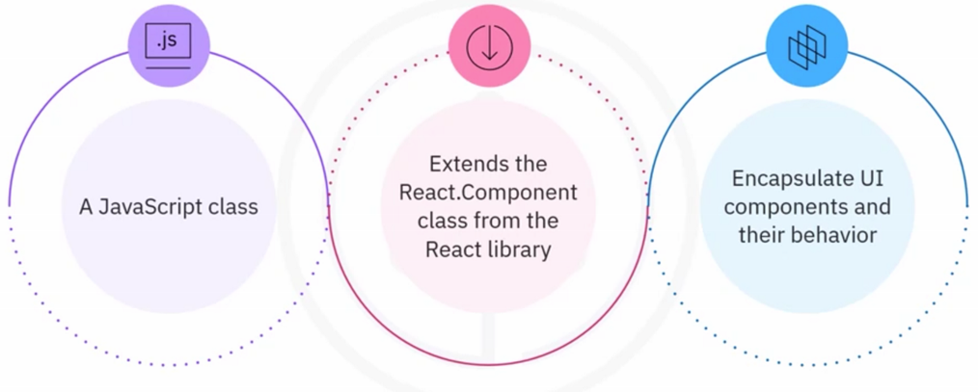
What is a class component?

Slide 4
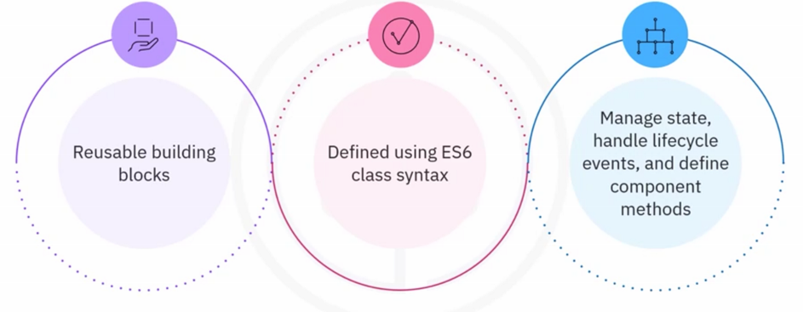
What is a class component?

Slide 5
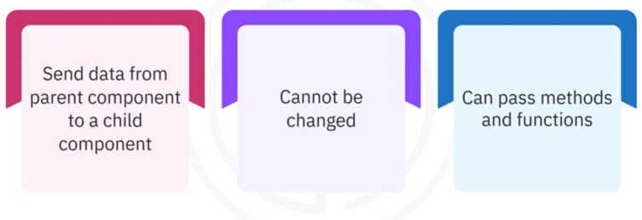
Props in-class component

Slide 6
Recap
In this video, you learned that:
• A class component in React is a JavaScript class that extends the React.Component
class from the React library
• Class components encapsulate UI components and their behavior into reusable building
blocks
• Class components manage state, handle lifecycle events, and define component
methods
• State represents the data that the component needs to render and respond to user
interactions
• In React, props or properties send data from parent to child components
• Event handling in React is the process of responding to user interactions, such as clicks,
mouseover, mouseout, form submissions, and so on, within a React application

